Slide 1

ROUTE BUS PASS SYSTEM
ITA0203-WEB TECHNOLOGY FOR FREE LANCER
TEAM 13
Supervisor
Dr. MOORTHY A
Dr. A.M.ARUL RAJ
Professor
Saveetha School of Engineering
Student
S.VIDDHIYA SREE-192421188
I.THULASI-192421032
Department of IT
Saveetha School of Engineering

Slide 2


AIM & OBJECTIVE
To develop a digital Route Bus Pass System that allows users to easily apply and manage bus passes online, while enabling administrators to verify, approve, and monitor applications efficiently, reducing manual work and saving time.

Slide 3
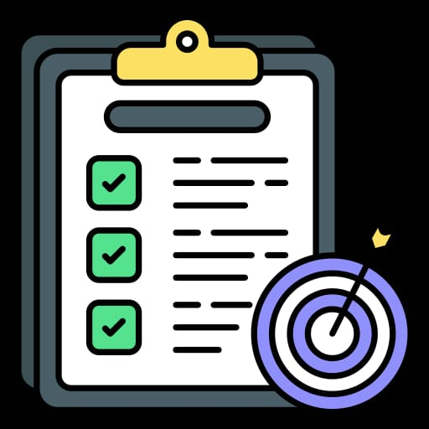
ABSTRACT
The Route Bus Pass System is an online platform that automates bus pass applications and approvals. Users can apply, pay, and track passes, while admins manage applications, routes, and records. This system ensures a fast, transparent, and efficient bus pass process.

Slide 4
LITERATURE REVIEW
Author / Year | Title | System | Findings
Smith, 2018 | Digital Bus Pass Management | Online application system for bus passes | Reduced manual work and waiting time for users
Kumar & Rao, 2019 | Web-Based Transportation Solutions | Developed a web portal for pass issuance | Improved efficiency, real-time tracking of passes
Li et al., 2020 | User-Admin Interlinked Systems | Separate modules for users and admins | Enhanced workflow; admins manage applications, users track status
Sharma, 2021 | Automated Public Transport Services | Online forms, payment integration | Increased transparency and reduced errors in pass issuance
Gupta & Singh, 2022 | Bus Pass System with Payment Gateway | Web application with integrated payment system | Seamless user experience; real-time updates for users and admins

Slide 5
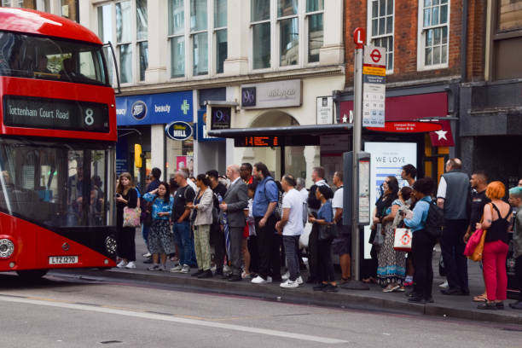
PROBLEM STATEMENT
Manual bus pass systems cause long queues and delays.
High chance of data errors and mismanagement.
Users cannot track application status easily.
Administrators face difficulty in managing applications, routes, and payments.
Lack of transparency in the pass issuance process.
Need for an automated online system to streamline applications, approvals, and payments.

Slide 6
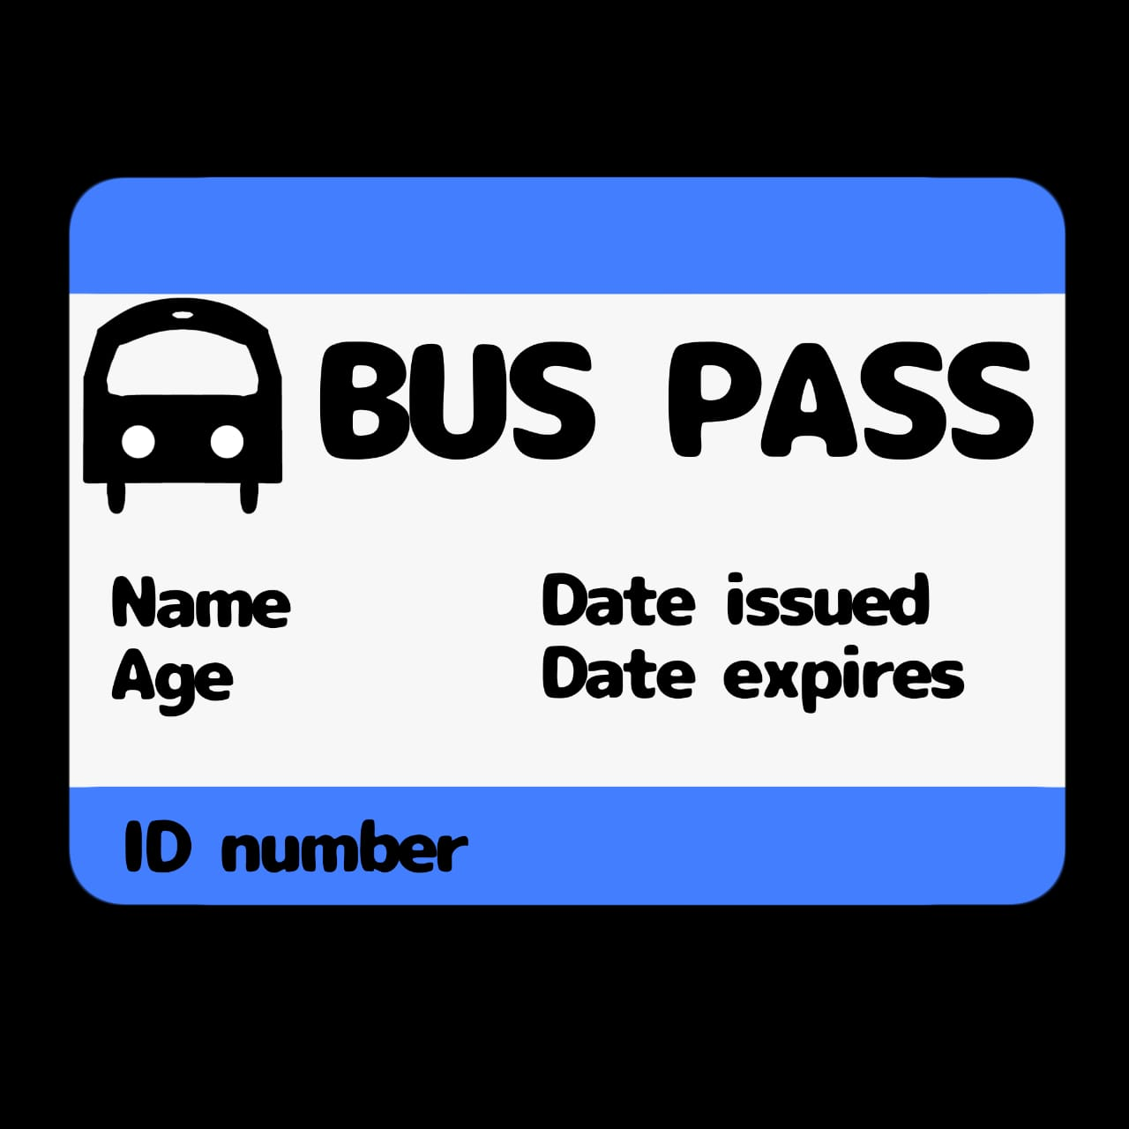
EXISTING SYSTEM
Bus passes are issued manually at transport offices.
Users need to stand in long queues to apply and make payments.
Application verification and approval are time-consuming.
Tracking the status of applications is difficult for users.
Administrators maintain records manually, leading to errors.
Lack of real-time updates and transparency in the process.

Slide 7
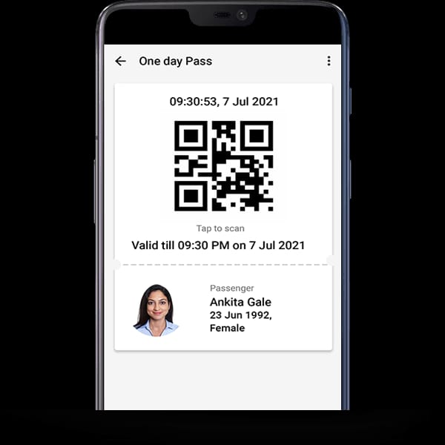
PROPOSED SYSTEM
Online platform to apply, pay, and track bus passes.
Admin module for verifying applications and managing routes.
Real-time updates between users and admins
Reduces manual work, errors, and delays; ensures transparency.

Slide 8
HARDWARE AND SOFTWARE REQUIREMENT ANALYSIS
Front-End Development:
HTML, CSS, JavaScript → For creating user-friendly web interfaces.
Back-End Development:
Python (Flask/Django) or Java (Spring Boot) → For server-side logic.
Database Management:
MySQL / PostgreSQL → For storing user, pass, and route information.

Slide 9
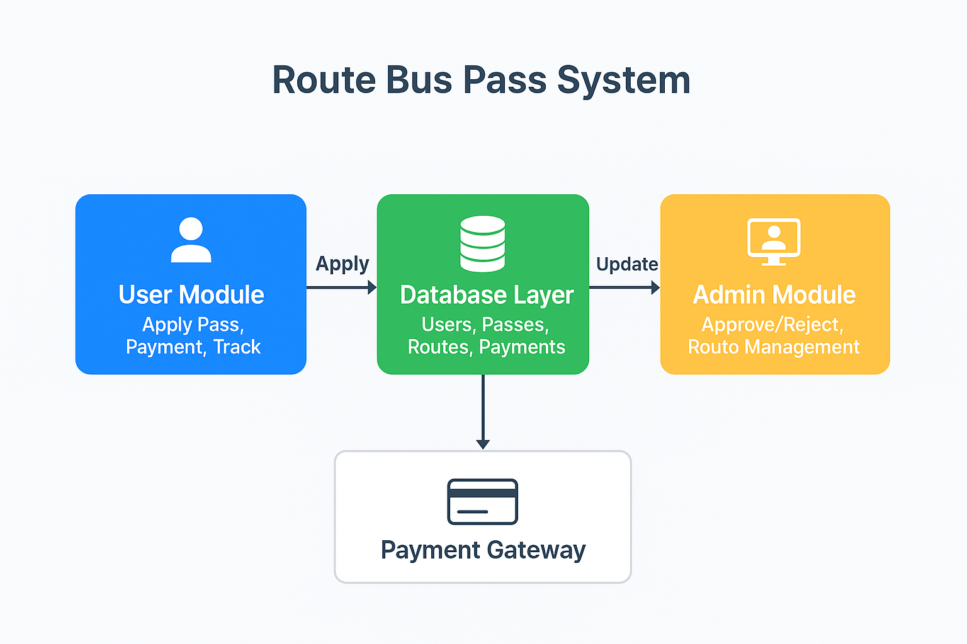
OVERALL SYSTEM ARCHITECTURE

Slide 10
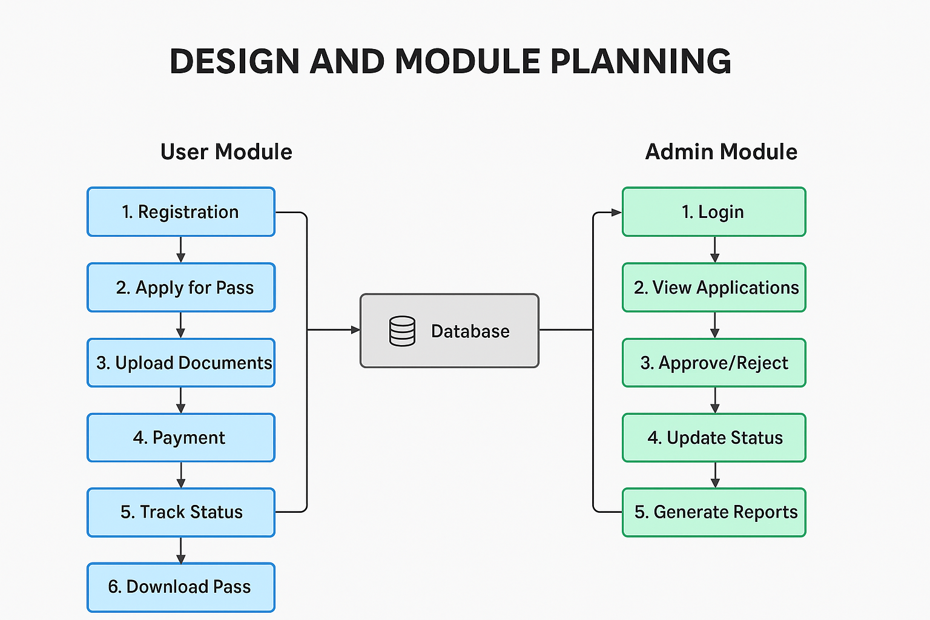
DESIGN AND MODULE PLANNING
MODULE 1 :BUS PASS APPLICATION AND MANAGEMENT
MODULE 2: BUS PASS APPROVAL AND ADMINISTRATION

Slide 11
MODULE 1:BUS PASS APPLICATION AND MANAGEMENT
The Bus Pass Application and Management Module is designed to simplify the process of obtaining and managing bus passes for users such as students, employees, and citizens.
This module allows users to register, apply for bus passes, select routes and pass types, make online payments, and track application status.
Approved passes can be downloaded or printed, and renewals are managed easily, providing a fast and convenient process.

Slide 12
MODULE 1:PURPOSE
To simplify the process of applying for and managing bus passes.
To allow users to register, submit personal and organization details, and select routes and pass types.
To enable online payment, application tracking, and secure pass download/printing.
To manage pass renewals efficiently, reducing manual work and saving time.

Slide 13
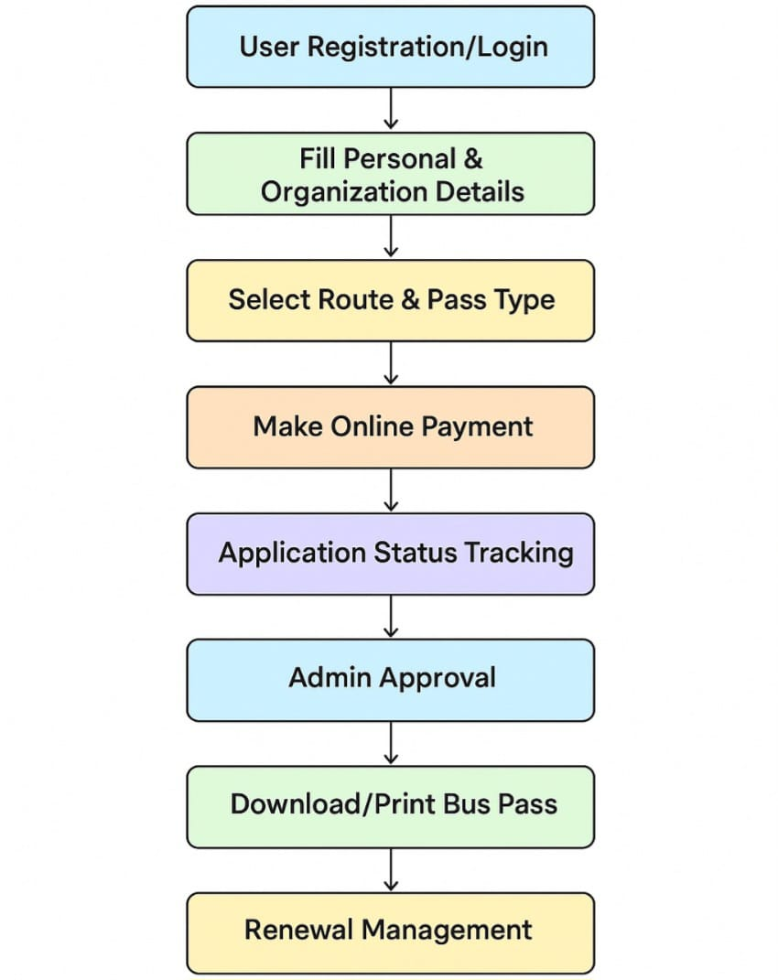
MODULE 1:SYSTEM DESIGN

Slide 14
TESTING AND REVIEW
Testing
Unit Testing → check each function individually
Integration Testing → verify interaction between modules
System Testing → validate full workflow end-to-end
User Acceptance Testing (UAT) → confirm with real users
Security Testing → ensure data and payment protection
Review
Code Review → maintain coding standards & reduce errors
Performance Review → check speed, load, efficiency
Requirement Review → ensure all features are implemented
Feedback Review → improve system based on user/admin input

Slide 15
MODULE 2: BUS PASS APPROVAL AND ADMINISTRATION
The Bus Pass Approval and Administration Module is a crucial part of the Route Bus Pass System.
It is designed to efficiently manage, verify, and approve bus pass applications submitted by users (students, employees, or citizens).
This module ensures that only eligible applicants receive passes while maintaining proper administrative control over routes, pass types, and validity periods.

Slide 16
Module 2: PURPOSE
Verify user details and eligibility for bus passes.
Approve or reject applications efficiently.
Manage issued passes, renewals, and cancellations.
Maintain administrative control over routes and users.
Generate reports for monitoring and decision-making.

Slide 17
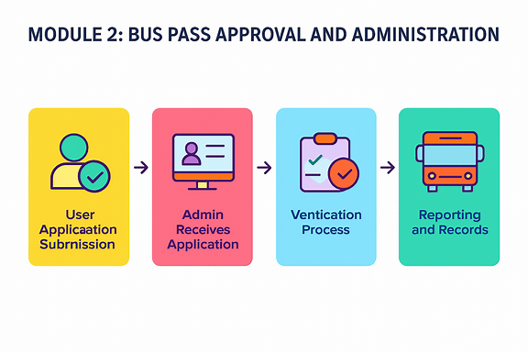
MODULE 2:SYSTEM DESIGN

Slide 18

TESTING & INTEGRATION WITH MODULE 1
Unit testing of approval, rejection, and reporting functions
Integration testing between User Module (Module 1) and Admin Module (Module 2)
System testing of full process: Application → Verification → Approval/Rejection → Issuance
User Acceptance Testing (UAT) with real users and admins
Security testing for safe data and payment handling

Slide 19
SYSTEM DEBUGGING AND OPTIMIZATION
Identify and fix errors in user and admin modules.
Validate inputs and ensure workflows function correctly.
Optimize database queries and reduce page load time.
Improve system speed, responsiveness, and modularity.
Ensure seamless integration and real-time notifications

Slide 20
FULL SYSTEM TESTING
Verify all features: submission, approval, rejection, and notifications.
Ensure smooth integration between User (Module 1) and Admin (Module 2).
Detect and fix errors, bugs, and workflow issues across modules.
Optimize system speed, database queries, and response time.
Validate user-friendliness, easy navigation, and real-time notifications.
Confirm system is stable, responsive, and fully function

Slide 21
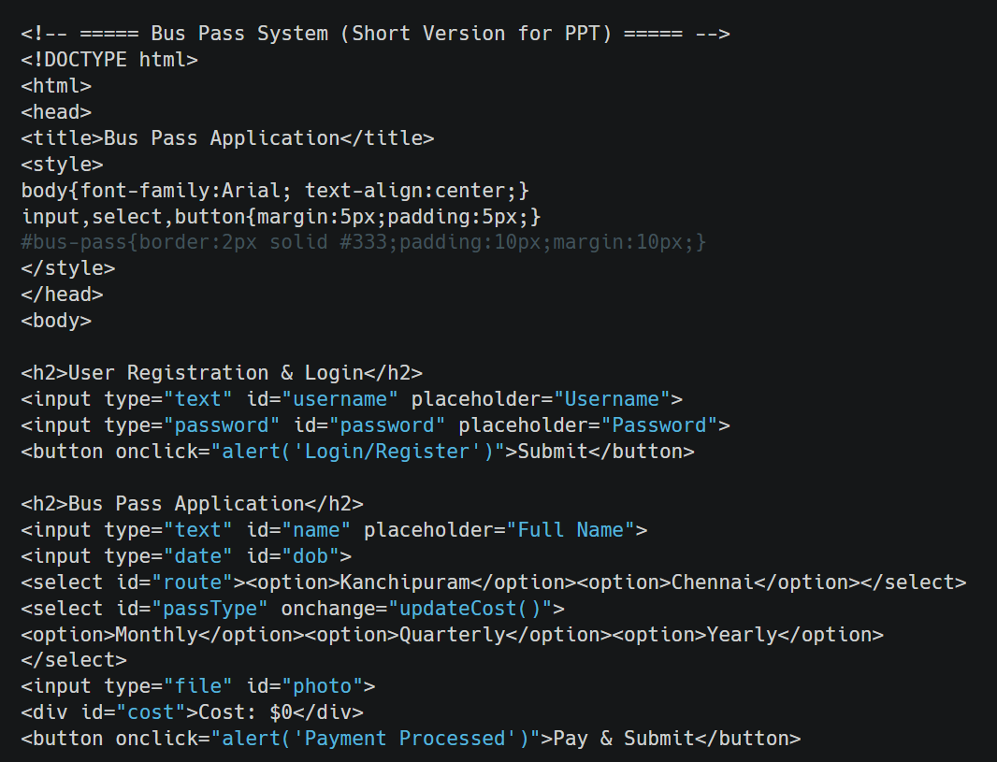
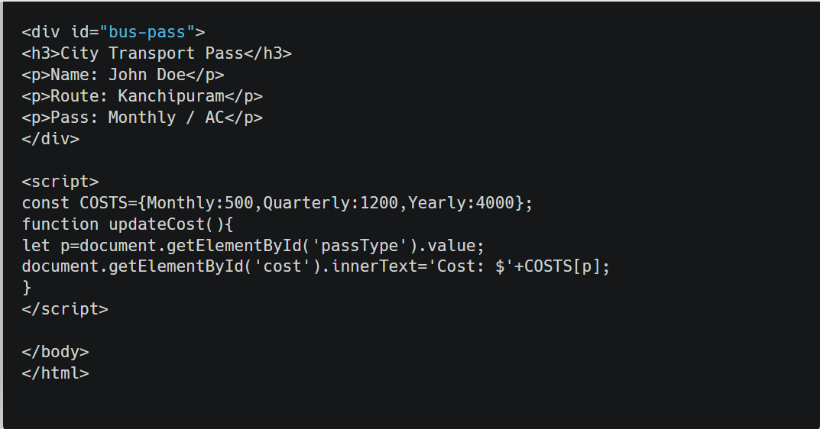
IMPLEMENTATION-CODE

Slide 22
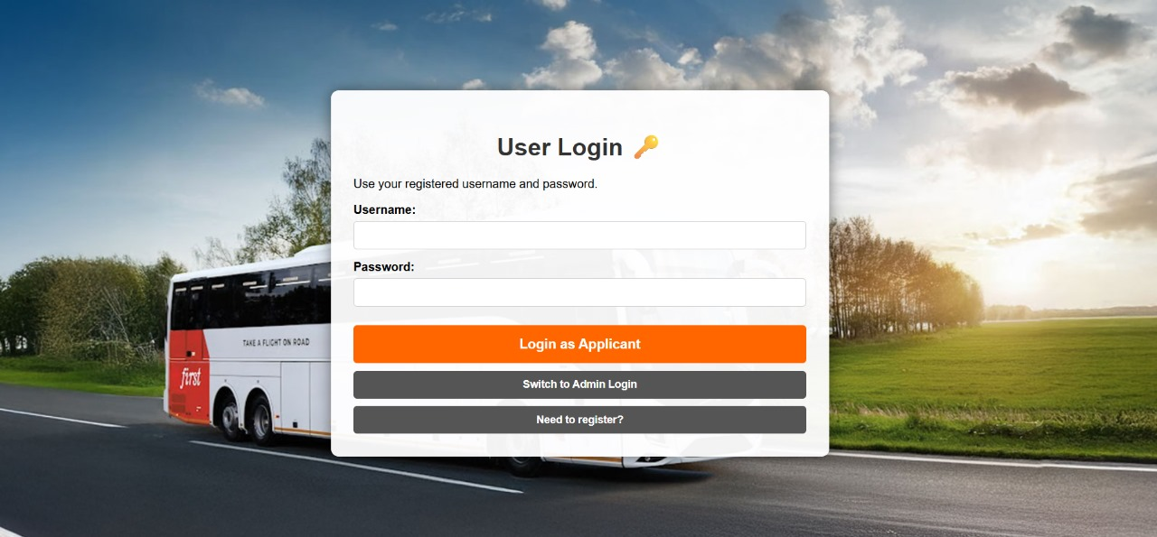
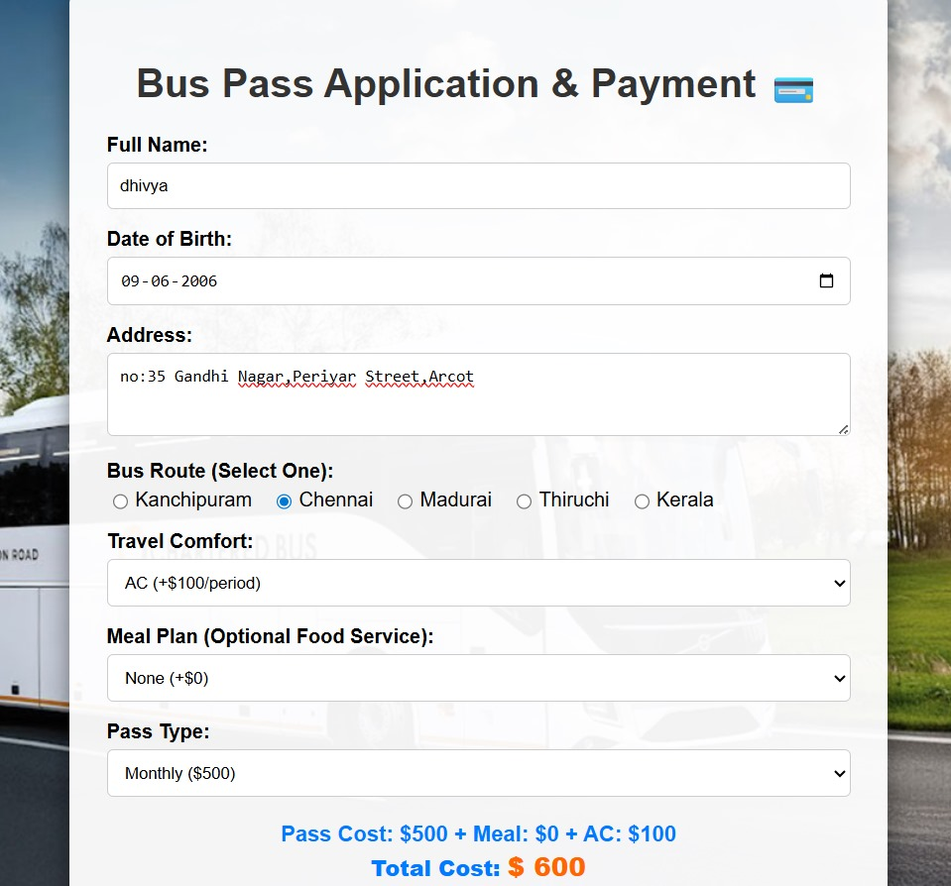
IMPLEMENTATION-RESULT
USER LOGIN

Slide 23
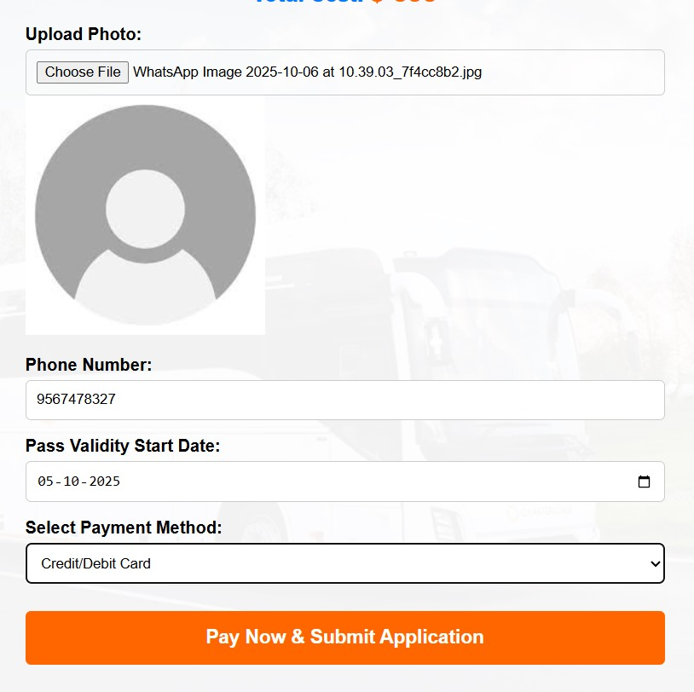
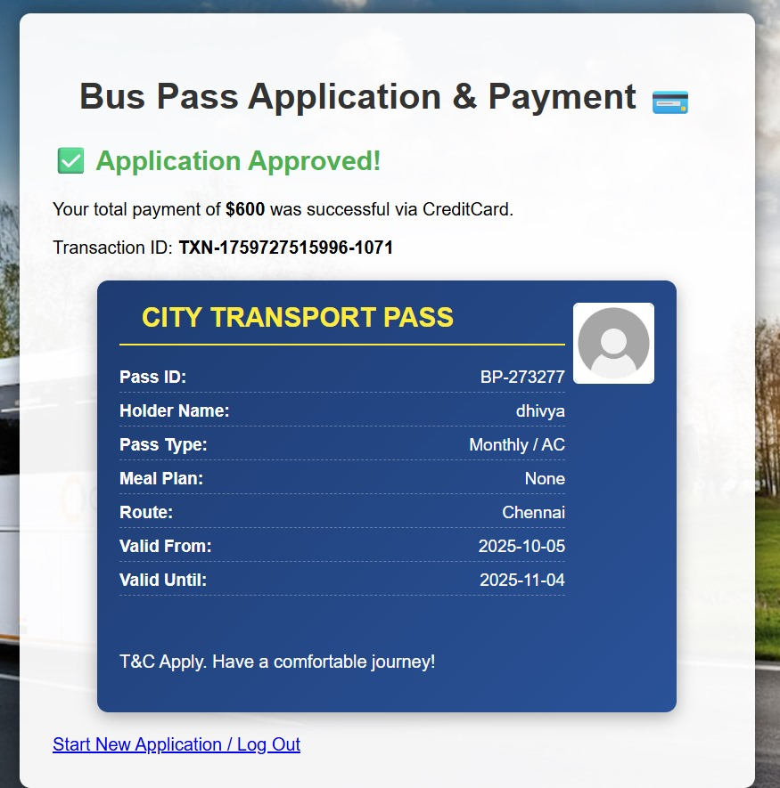

Slide 24
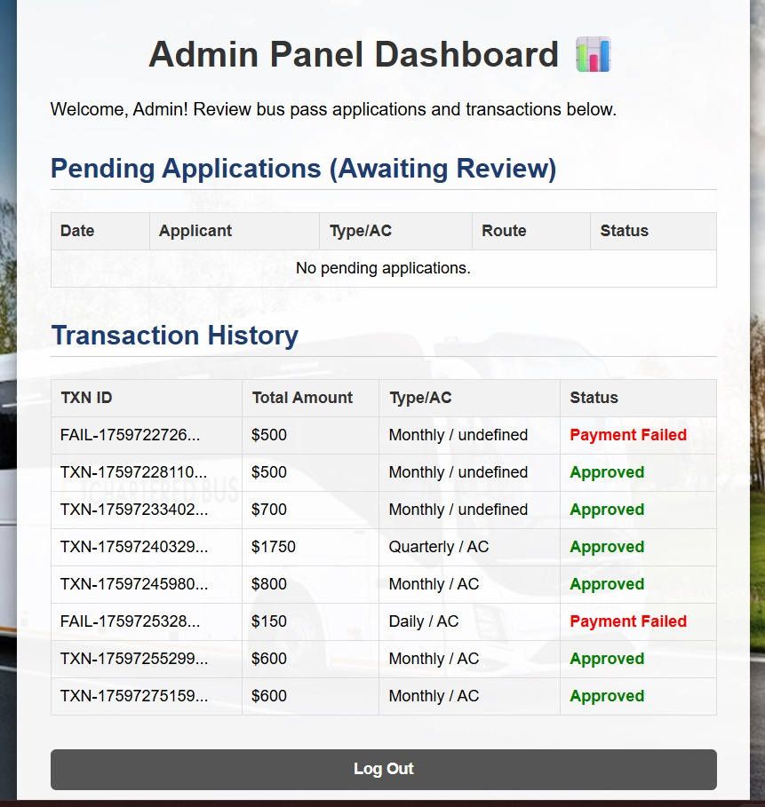
ADMIN LOGIN

Slide 25
Conclusion
The Route Bus Pass System successfully automates the process of issuing, managing, and tracking bus passes for users like students, employees, and citizens.
By integrating the User and Admin modules, the system ensures a fast, transparent, and secure process, reducing manual paperwork and errors.
This system not only saves time and effort but also improves overall service delivery and accountability in bus pass administration.

Slide 26
FUTURE ENHANCEMENT
Mobile Application – Develop an Android/iOS app for easier access and pass management on the go.
GPS Integration – Real-time bus tracking for users to check bus locations and estimated arrival times.
Automated Notifications – Alerts for pass expiry, payment reminders, and route changes via SMS or email.
Digital Pass with QR Code – Enable quick boarding and verification using QR codes. Analytics & Reports – Admin dashboard with reports on usage, revenue, and route performance for better decision-making.

Slide 27
Reference
Roy, U. K. (2020). Web Technologies: HTML, CSS, JavaScript, PHP, MySQL. New Delhi: Oxford University Press.
Ramakrishnan, R., & Gehrke, J. (2014). Database Management Systems (3rd ed.). McGraw-Hill Education
Kaur, R., & Singh, A. (2021). Smart Transportation Systems Using Web Technologies. International Journal of Computer Applications, 182(45), 12–18.
Date, C. J. (2019). An Introduction to Database Systems (8th ed.). Pearson.
W3Schools. (2025). SQL and Database Tutorials. Retrieved from https://www.w3schools.com/sql/

Slide 28
THANK YOU

